Slide 1
DATA VISUALIZATION
Done by:
G. Kalyani
J. Vageesa
N. Kusuma
B. Monisha

Slide 2

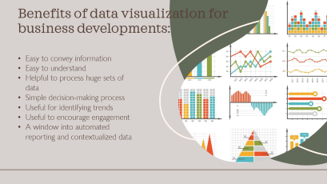
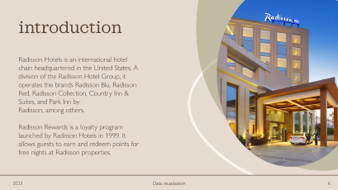
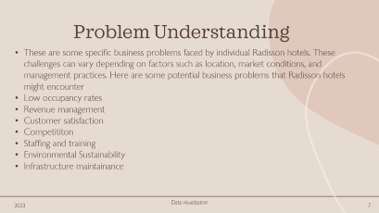
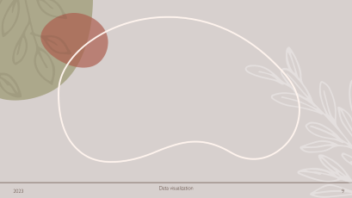
RADISSON HOTEL

Slide 3
RADISSON HOTEL

Slide 4
RADISSON HOTEL

Slide 5
RADISSON HOTEL

Slide 6

introduction
Radisson Hotels is an international hotel chain headquartered in the United States. A division of the Radisson Hotel Group, it operates the brands Radisson Blu, Radisson Red, Radisson Collection, Country Inn & Suites, and Park Inn by Radisson, among others.
Radisson Rewards is a loyalty program launched by Radisson Hotels in 1999. It allows guests to earn and redeem points for free nights at Radisson properties.

Slide 7
Problem Understanding
These are some specific business problems faced by individual Radisson hotels. These challenges can vary depending on factors such as location, market conditions, and management practices. Here are some potential business problems that Radisson hotels might encounter
Low occupancy rates
Revenue management
Customer satisfaction
Competititon
Staffing and training
Environmental Sustainability
Infrastructure maintainance

Slide 8
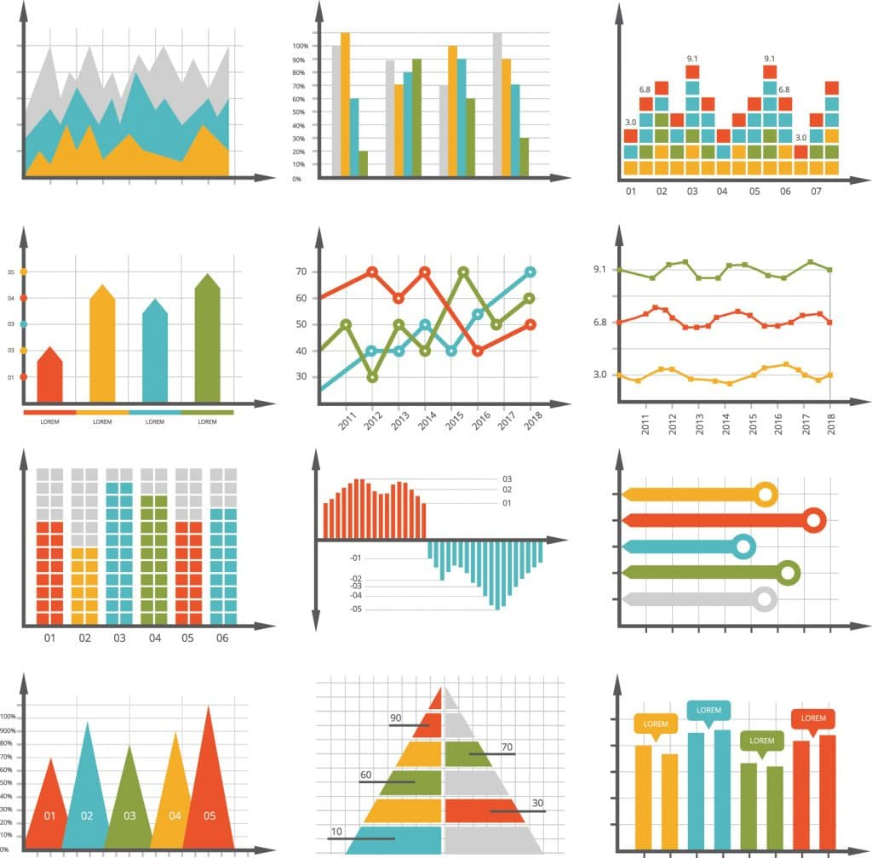
Benefits of data visualization for business developments:
Easy to convey information
Easy to understand
Helpful to process huge sets of data
Simple decision-making process
Useful for identifying trends
Useful to encourage engagement
A window into automated reporting and contextualized data

Slide 9
Tableau software
Tableau Software is an American interactive data visualization software company focused on business intelligence .It was founded in 2003 in Mountain View, California, and is currently headquartered in Seattle, Washington. In 2019 the company was acquired by Sales force for $15.7 billion . At the time, this was the largest acquisition by Sales force (a leader in the CRM field) since its foundation. It was later surpassed by Sales force's acquisition of Slack.
Tableau products query relational databases, online analytical processing cubes, cloud databases, and spreadsheets to generate graph-type data visualizations. The software can also extract, store, and retrieve data from an in-memory data engine.

Slide 10
Usage of tableau software:
Connect to and prepare data
Build charts
Analyse data
Create dashboards and stories
Optimise workbook performance
Save work
Publish data sources and workbooks

Slide 11
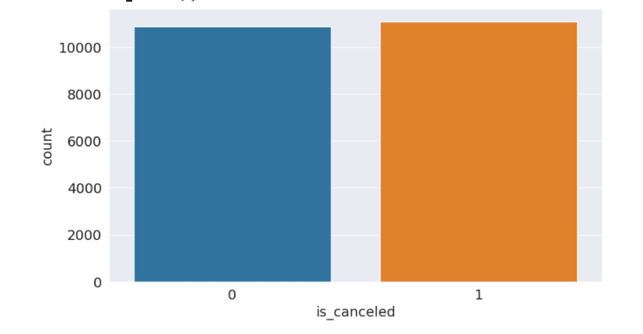
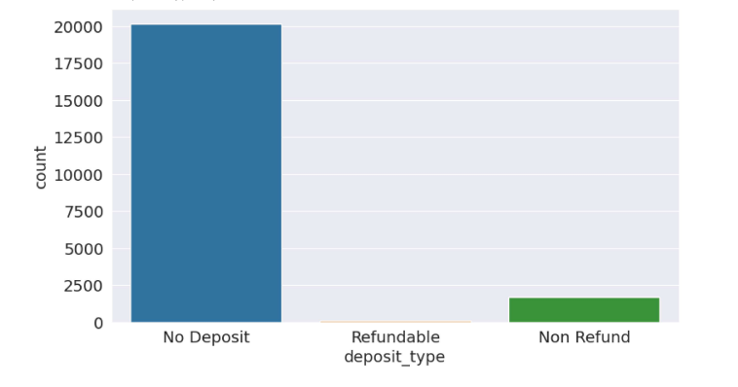

Slide 12
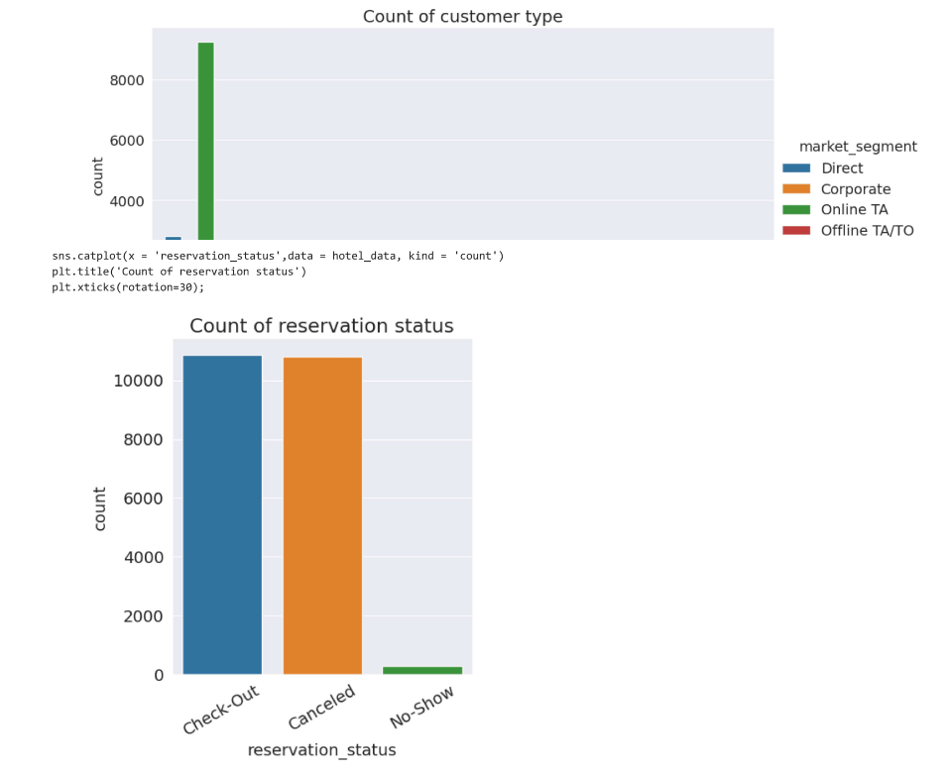
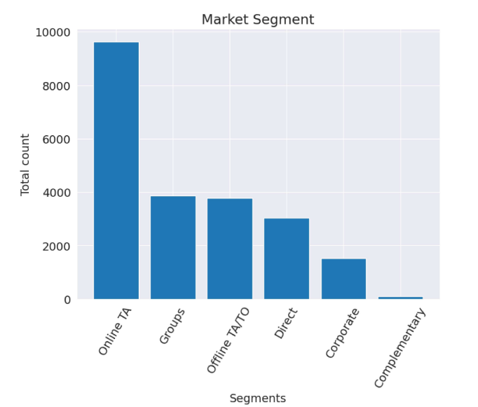

Slide 13
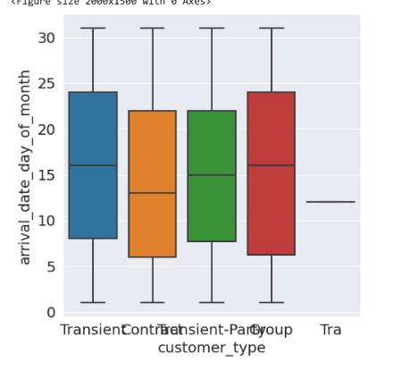
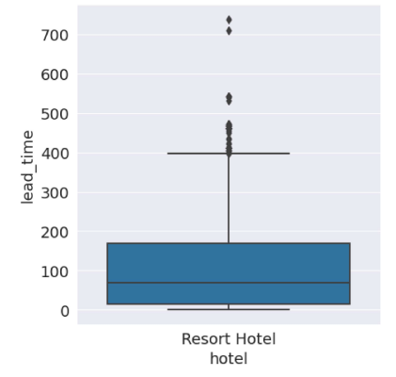

Slide 14
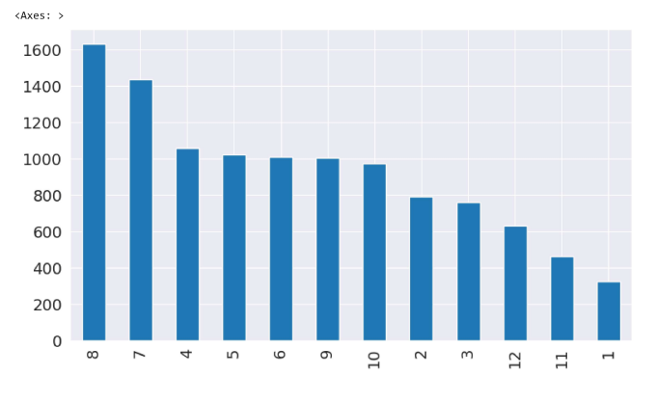
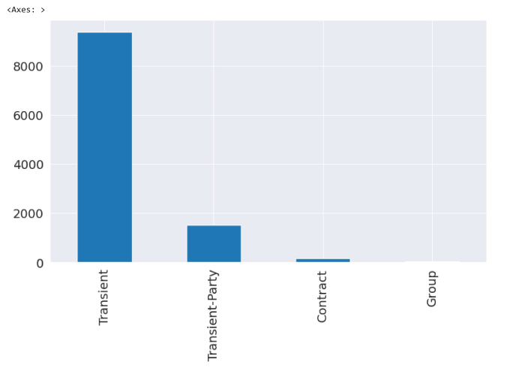

Slide 15
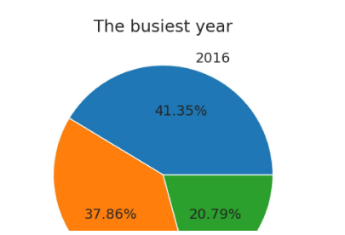
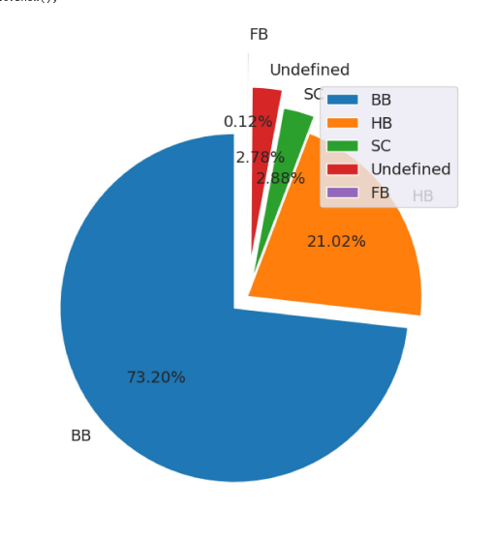
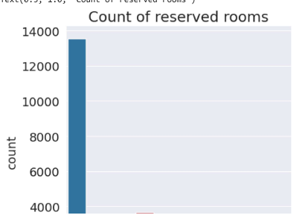

Slide 16
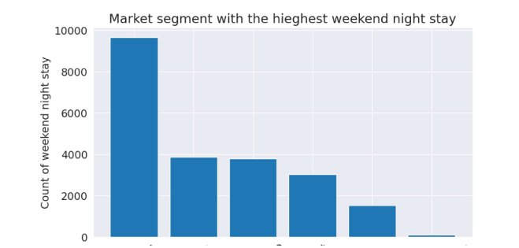
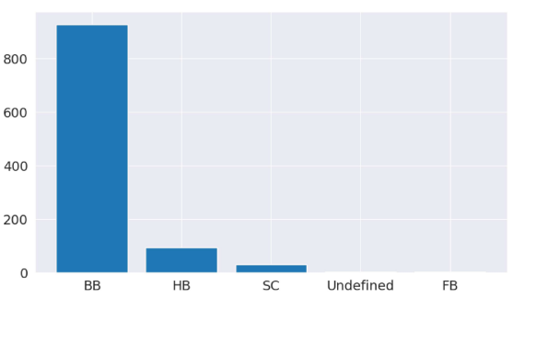

Slide 17

Project link :
https://github.com/GORUPUTIKALYANI/DATA-VISUALIZATION.git

Slide 18
thank you

